Slide 1
Exploratory Data Analysis
Next, we completed EDA for the dataset, evaluating individual features and the response as well as the relationships between data fields.
Performed univariate analysis to explore distributions, observing and flagging any outliers for further action during modeling and analysis
Investigated feature/DV relationships using pairplots and correlation, forming hypotheses about which features would provide the most value to the model
Evaluated multicollinearity between predictors using a correlation heatmap, identifying whether or not mitigations measures will need to be taken

Slide 2
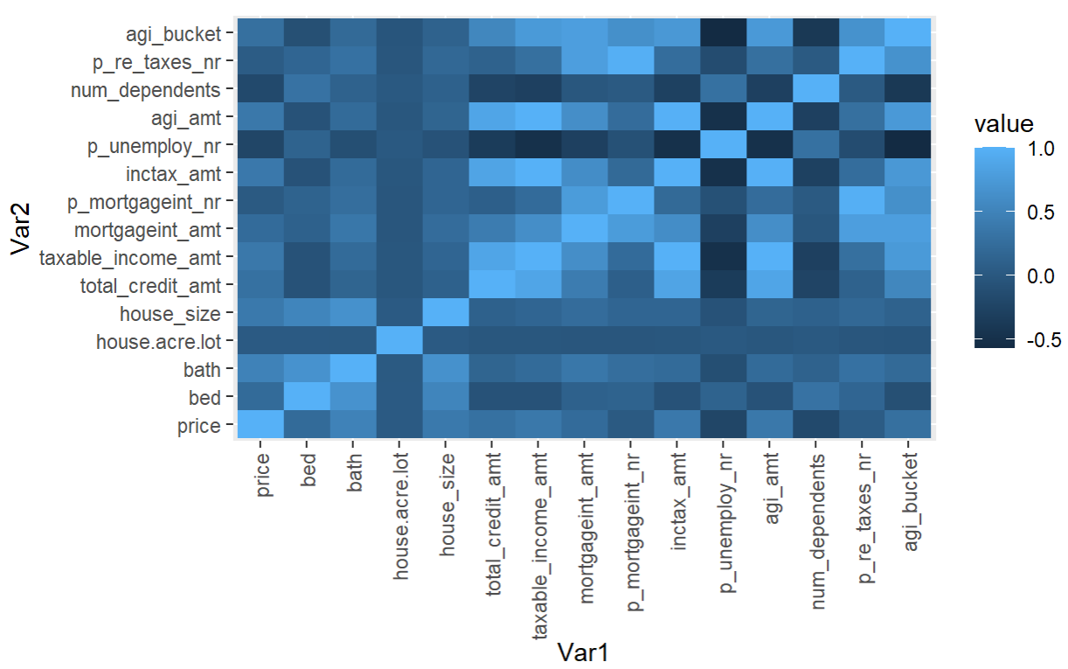
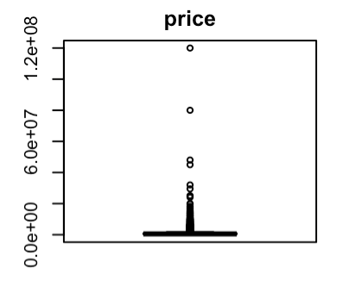
Observations and Initial Hypotheses
During EDA, a few notable observations surfaced, along with initial hypotheses.
Feature | Correlation with Price
total_credit_amt | 0.290
taxable_income_amt | 0.375
mortgageint_amt | 0.234
p_mortgageint_nr | 0.024
inctax_amt | 0.378
p_unemploy_nr | -0.215
agi_amt | 0.372
num_dependents | -0.179
p_re_taxes_nr | 0.046
agi_bucket | 0.278
bed | 0.218
house_size | 0.395
house_acre_lot | 0.030
bath | 0.490
Univariate analysis revealed outliers in the price field which we will further investigate
Investigation of correlation between price and income tax features reveals limited linear signal
Evaluation of multicollinearity showed correlation between predictors, particularly in the income tax dataset
INITIAL HYPOTHESES
Real estate features are expected to provide the most signal to the model
Tax features related to affluency have the most potential to provide signal to the model
Tree-based models will likely far outperform linear models

